Slide 1

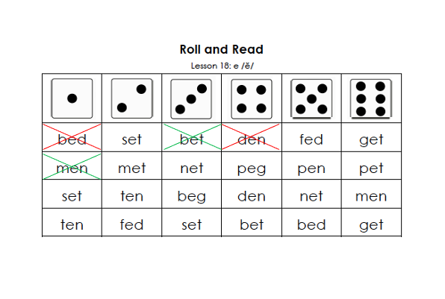
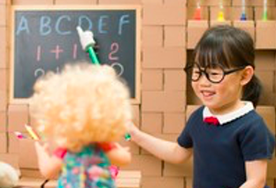
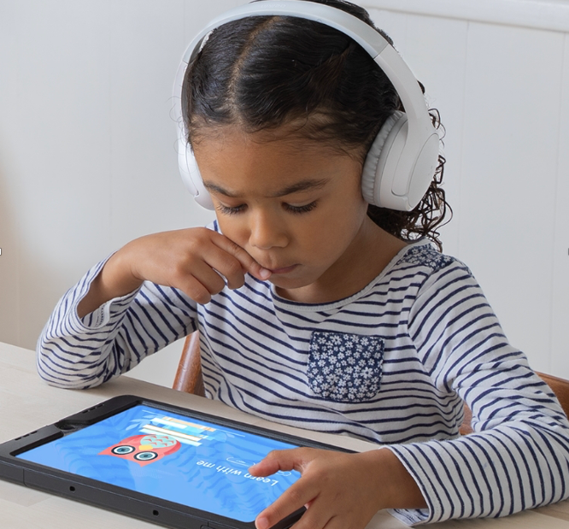
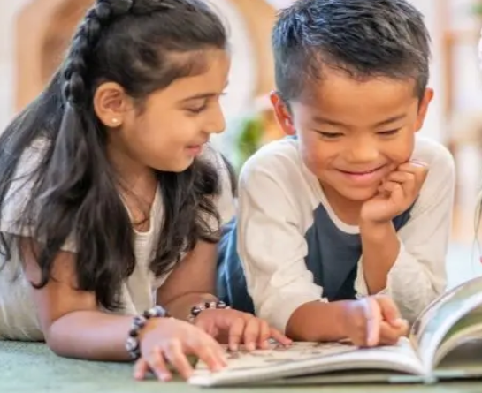
Learning Centers

Slide 2
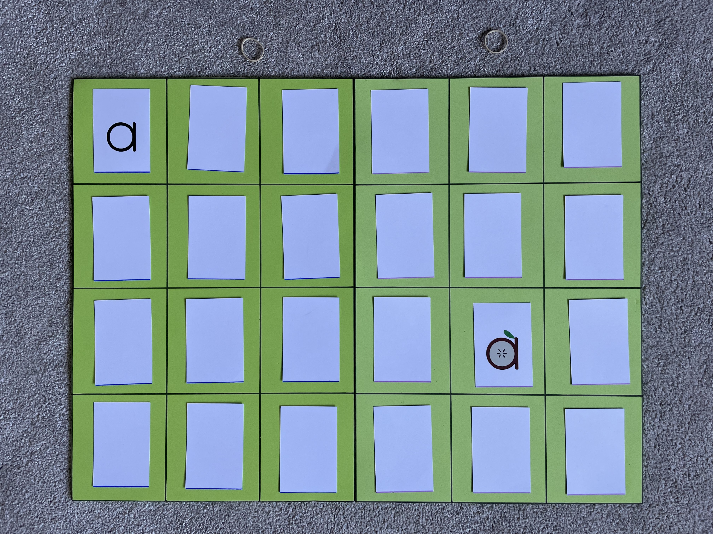
Memory Match
Cove / Marenos
Jordan
Simon / Aminaeb
Rodrick
Lukas / Stella
Gabriel
Listen to a Story
Danella
Leera
Elyah
Hunter
Joshua
Dominion
Aisha
Charbel
Eren
Saif

Slide 3
Tidy Up!

Slide 4
Memory Match
Danella / Leera
Elyah
Hunter / Joshua
Dominion
Charbel / Aisha
Eren / Saif
Listen to a Story
Cove
Marenos
Jordan
Simon
Aminaeb
Rodrick
Lukas
Stella
Gabriel

Slide 5


Slide 6
Listen to a Story
Cove
Marenos
Jordan
Simon
Aminaeb
Rodrick
Lukas
Stella
Gabriel
Listen to a Story
Danella
Leera
Elyah
Hunter
Joshua
Dominion
Aisha
Charbel
Eren
Saif
Listen to a Story

Slide 7
Read to a Friend
Simon & Joshua
Hunter & Danella
Cove & Charbel
Leera & Elyah
Read to a Friend
Stella & Gabriel
Lukas & Marenos
Rodrick & Aminaeb
Aisha & Jordan
Read to a Friend

Slide 8
Roll & Read
Simon & Joshua
Hunter & Danella
Cove & Charbel
Leera & Elyah
Roll & Read
Stella & Gabriel
Lukas & Marenos
Rodrick & Aminaeb
Aisha & Jordan
Roll & Read

Slide 9
Memory Match
Cove / Marenos
Jordan
Simon / Aminaeb
Rodrick
Lukas / Stella
Gabriel
Memory Match
Danella / Leera
Elyah
Hunter / Joshua
Dominion
Charbel / Aisha
Eren / Saif
Memory Match

Slide 10
Be a Teacher
Simon & Joshua
Hunter & Danella
Cove & Charbel
Leera & Elyah
Be a Teacher
Stella & Gabriel
Lukas & Marenos
Rodrick & Aminaeb
Aisha & Jordan
Be a Teacher

Slide 11

Write
Cove
Marenos
Jordan
Simon
Aminaeb
Rodrick
Lukas
Stella
Gabriel
Write
Danella
Leera
Elyah
Hunter
Joshua
Dominion
Aisha
Charbel
Eren
Saif
Write

Slide 12
